Slide 1

Zero Trust: Malicious Network Traffic Detector
Case Study in Binary Classification
Amie Davis, amodavis@my365.bellevue.edu, DSC680, Bellevue University, 1 June 2021

Slide 2
Overview
Business Problem
Data Summary
Feature Reduction
Research Questions
Modeling Objective
Model Assessment
Deployment
Future Recommendations

Slide 3
Business Problem
Increased system accessibility invites an increase in malicious cybersecurity threats.
We need to allow personnel to work from remote locations and continue to be productive. Access is required whether using company devices over a VPN or a personal device.
Notes:
VPN = Virtual Private Network

Slide 4
Business Objective
Identify network traffic that should be blocked, regardless of device or physical location.

Slide 5

Tor
The Onion Router
Background
Created so that “internet users should have private access to an uncensored web”
Allows users to browse the web anonymously by encrypting and routing requests through multiple relays
Joint Cybersecurity Advisory advises to monitor against Tor traffic
“While Tor can be used to promote democracy and free, anonymous use of the internet, it also provides an avenue for malicious actors to conceal their activity because identity and point of origin cannot be determined for a Tor software user”
Alert (AA20-183A): Defending Against Malicious Cyber Activity Originating from Tor. Cybersecurity and Infrastructure Security Agency CISA. (2020, October 24). https://us-cert.cisa.gov/ncas/alerts/aa20-183a.
Notes:
CISA = Cybersecurity and Infrastructure Security Agency

Slide 6

Data Source
DarkNet 2020 dataset from the Canadian Institute for Cybersecurity at the University of New Brunswick
Wireshark – Packet analyzer
Data analyzed and labeled as either malicious (Tor) or benign (non-Tor)
Traffic categories
Audio-Stream, Browsing, Chat, Email, Peer-to-Peer, File Transfer, Video-Stream
Source, Destination IPs, Ports, Protocols
CIC-Darknet2020. University of New Brunswick. (n.d.). https://www.unb.ca/cic/datasets/darknet2020.html.

Slide 7
Data Summary
Original dataset included 141,530 Wireshark records with 85 features
Both VPN and Tor analyzed records
Restricted Tor and Non-Tor labeled records
NULL and Infinity Values
Number of Flow Bytes and Flow Packets
94,748 cleansed records

Slide 8
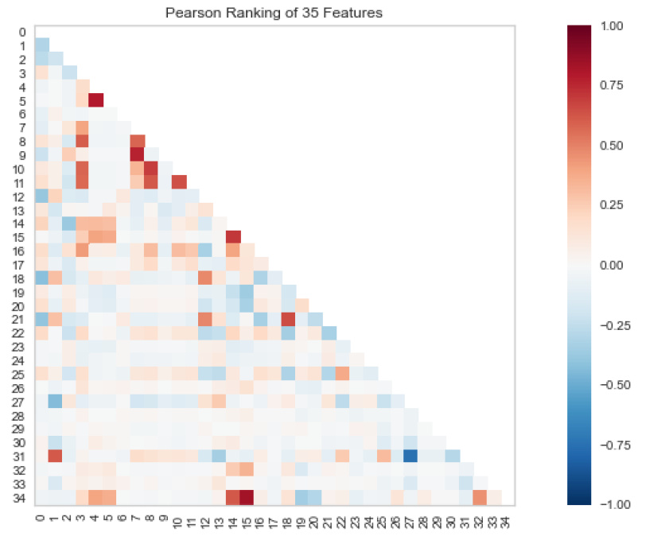
Feature Reduction
Original dataset 85 features
Removed zero value columns
Split ip addresses - numeric
Correlation (> 0.8)
Reduced to 35 features.

Slide 9
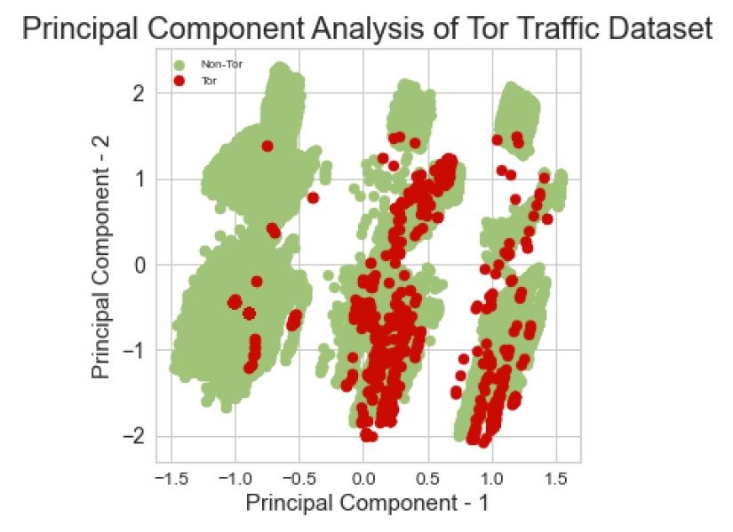
PCA
First principal component contains 27.9% of the variance
Second principal component contains 16.9% of the variance
Together they contain 44.8% of the info
Non-linear separation
Notes:
PCA = Principal Component Analysis

Slide 10
Research Questions
How do you know traffic is malicious?
What features contribute the most to Tor traffic?
From what ip subnet is Tor traffic most likely to come?
How much Tor traffic is detected by each category?
Is Tor traffic faster or slower than non-Tor traffic?
Is Tor traffic larger or smaller than non-Tor traffic?

Slide 11
Data Analysis
How do you know traffic is malicious?

Slide 12
Malicious Traffic
You never know whether traffic is malicious until a malicious action is taken.
That is too late.
This project addresses only one type of malicious traffic, Tor.

Slide 13
Data Analysis
2) What features contribute the most to Tor traffic?

Slide 14
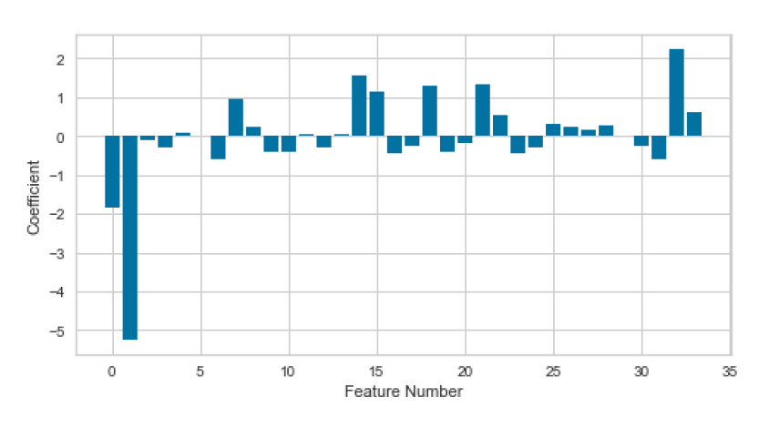
Feature Importance
Model coefficients
Positive scores predict class 1 (Tor)
Negative scores predict class 0 (Non-Tor)
Feature 1, b = -5.2, Destination Port
Feature 32, b = 2.2, VOIP indicator
Notes:
VOIP = Voice Over IP

Slide 15
Data Analysis
3) From what ip subnet is Tor traffic most likely to come?

Slide 16
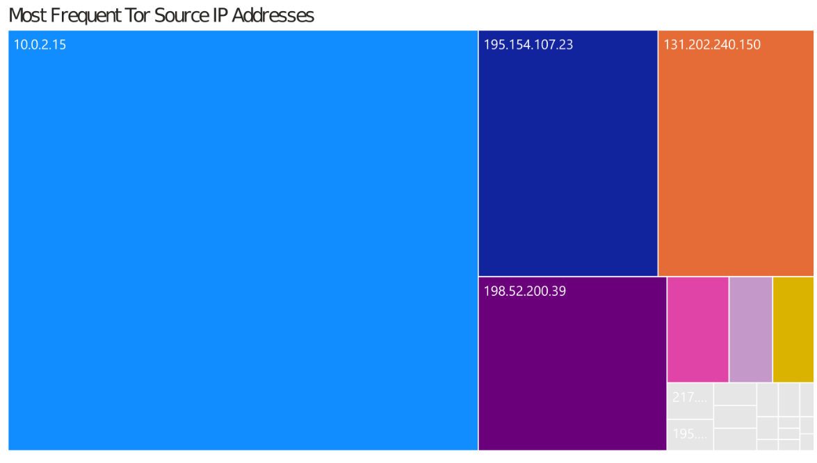
Tor Source Addresses
IP Address Locator
Private LAN
Paris, France
New Brunswick, Canada
Johnson City, Tennessee

Slide 17
Data Analysis
4) How much Tor traffic is detected by each category?

Slide 18
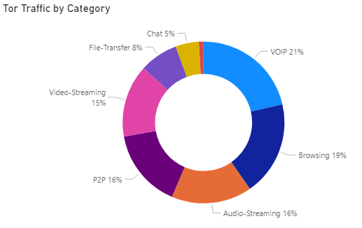
Traffic Categories
VOIP
Browsing
Audio-Stream
Peer-to-Peer
Video-Stream
File Transfer
Chat
Email
Notes:
VOIP = Voice Over IP

Slide 19
Data Analysis
5) Is Tor traffic faster or slower than non-Tor traffic?

Slide 20
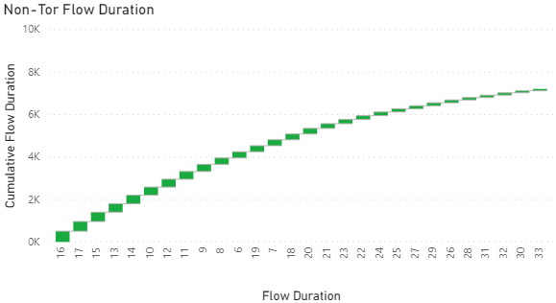
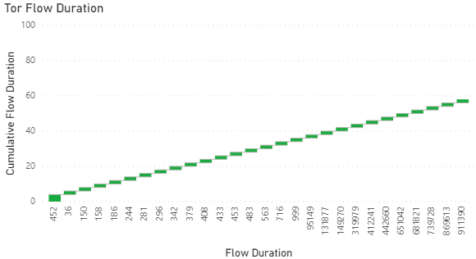
Packet Speed
Flow Duration
Length of connection in seconds
Most common non-Tor duration is 16 seconds
Most common Tor duration is 452 seconds (over 7 minutes)
Some common durations for Tor traffic over 100,000 seconds (over 1 day)

Slide 21
Data Analysis
6) Is Tor traffic larger or smaller than non-Tor traffic?

Slide 22
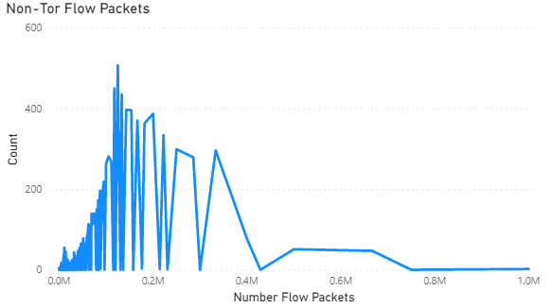
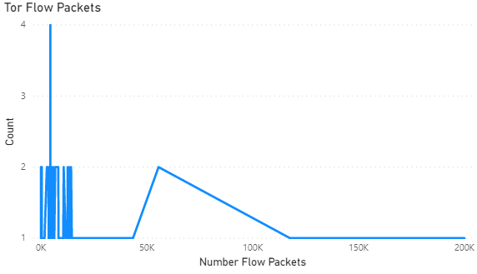
Packet Size
Flow Packets
Number of packets in each data flow
Range 0.2 to 125,000 for non-Tor
Range 0.2 to ~60,000 for Tor

Slide 23
Modeling Objective
Perform supervised learning to predict whether network traffic is Tor.

Slide 24
Model Selection
Logistic Regression

Slide 25
Data Preparation
Numeric features
Encoded traffic categories
Scaler Standardization
Training/Validation Split

Slide 26
Imbalanced Classes
2% Tor vs 98% Non-Tor
Scikit-Learn’s LogisticRegression
Hyperparameter class_weight = ‘balanced’

Slide 27
LogisticRegression Solvers
solver hyperparameter
lbfgs; approximates the Broyden–Fletcher–Goldfarb–Shanno algorithm; for small datasets
liblinear; uses coordinate descent (CD) algorithm; acts as a multiclass classifier
newton-cg; supports only L2 regularization
sag - uses Stochastic Average Gradient descent; faster for larger datasets
saga - SAG that supports L1 regularization

Slide 28
Assessment Metrics
Accuracy
Precision
Recall
F1
Matthews Correlation Coefficient (MCC)

Slide 29
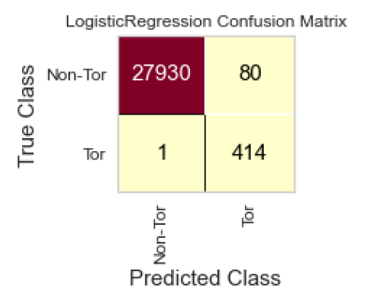
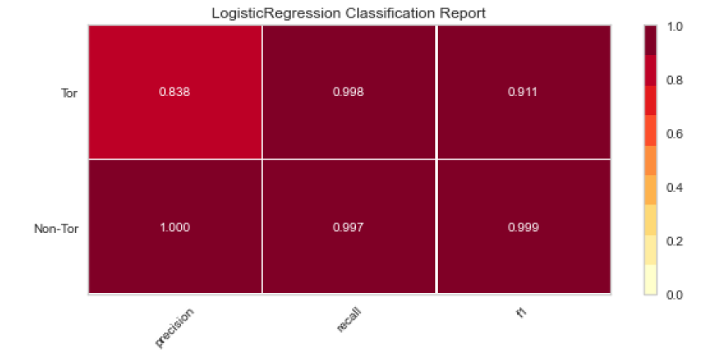
Model Assessment
Accuracy = (True Positives + True Negatives)/All
Accuracy not the best measure since the target class is imbalanced.
Reviewed counts of false predictions
Classification Report: The darker, the better.
Predictions for both Tor and Non-Tor traffic were good for all metrics
Precision showed a slightly lower result for records identified as Tor.

Slide 30
Model Assessment
Solver | MCC | # False Negatives
lbfgs | 91% | 0
liblinear | 94% | 0
newton-cg | 95% | 0
sag | 91% | 1
saga | 89% | 1
MCC results of solver comparison
Best MCC is with newton-cg at 95%.
To avoid overfitting, will select sag with an MCC of 91%

Slide 31
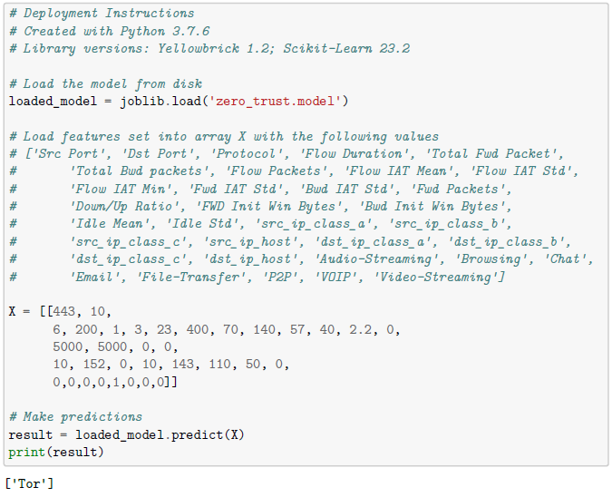
Deployment

Slide 32
Future Recommendations
Add model to streaming pipeline
Block Tor traffic at the firewall as it is detected
Repeat at all checkpoints
Override Requests
Expand for other CISA alerts

Slide 33
Continual Assessment
Not just the boundary
Users/ Devices
Activity/ Access
“Never trust, always verify.”

Slide 34
References
Alert (AA20-183A): Defending Against Malicious Cyber Activity Originating from Tor. Cybersecurity and Infrastructure Security Agency CISA. (2020, October 24). https://us-cert.cisa.gov/ncas/alerts/aa20-183a.
Chicco, D., & Jurman, G. (2020, January 2). The advantages of the Matthews correlation coefficient (MCC) over F1 score and accuracy in binary classification evaluation. BMC Genomics. https://bmcgenomics.biomedcentral.com/articles/10.1186/s12864-019-6413-7.
CIC-Darknet2020. University of New Brunswick. (n.d.). https://www.unb.ca/cic/datasets/darknet2020.html.
sklearn.linear_model.LogisticRegression. scikit-learn. (n.d.). https://scikit-learn.org/stable/modules/generated/sklearn.linear_model.LogisticRegression.html.

